Slide 1
Data Structures
& Libraries Part II
-- Erick Kwantan

Slide 2
Linear Data Structures (Built-in Libraries)
Array of Booleans If array only to contain Boolean value (0 or 1) use bitset. The bitset supports useful operations like reset(), set(), and test(). Refs: http://www.cplusplus.com/reference/bitset/bitset/
Linked List Linked List is usually avoided in typical (contest) problems due to the inefficiency in accessing items and the usage of pointers makes it prone to RTE if not implemented properly. Refs: http://www.cplusplus.com/reference/list/list/ http://www.cplusplus.com/reference/forward_list/forward_list/

Slide 3
Linear Data Structures (Built-in Libraries)
Stack Often used as part of algorithms that solve certain problems. This behavior is usually referred to as Last In First Out (LIFO). Typical operations include push(), pop(), top(), empty(). Refs: http://www.cplusplus.com/reference/stack/stack/
Queue Used in algorithms like Breadth First Search (BFS). This behavior is similarly referred to as First In First Out (FIFO). Typical operations include push(), pop(), front(), back(), empty().Refs: http://www.cplusplus.com/reference/queue/queue/

Slide 4
Linear Data Structures (Built-in Libraries)
Deque (Double-ended Queue) O(1) insertions and deletions at both the beginning and the end of the deque. Typical operations include push_back(), pop_front(), push_front(), pop_back(). Refs: http://www.cplusplus.com/reference/deque/deque/
Bitmask Small sets of Booleans. An integer stored as a sequence of bits. You can use vector<bool>, bitset, or set<int>. Also you can use Integer to represent a lightweight small set of Boolean values. Refs: http://www.cplusplus.com/reference/bitset/bitset/

Slide 5
Bitmask
Representation: A 32 / 64 - bit integer for up to 32 / 64 items. 5| 4| 3| 2| 1| 0 (0 index from right) 32|16| 8| 4| 2| 1 (power of 2) S = 34 (base 10) = 1| 0| 0| 0| 1| 0 (base 2) In the example above, the integer S = 34 or 100010 in binary can be represents a small set {1, 5}

Slide 6
Bitmask
To multiply/divide an integer by 2, we only need to shift the bits left/right.
Power of 2 --> 64 32 16 8 4 2 1 S = 34 = 1 0 0 0 1 0
S = S << 1 = S*2 = 68 = 1 0 0 0 1 0 0
S = S >> 2 = S/4 = 17 = 1 0 0 0 1
S = S >> 1 = S/2 = 8 = 1 0 0 0

Slide 7
Bitmask
To set/turn on the i-th item of the set, use the bitwise OR operations. Power of 2 --> 32 16 8 4 2 1 S = 34 = 1 0 0 0 1 0 i = 3, 1 << i = 1 0 0 0 ----------------- OR S = 42 = 1 0 1 0 1 0

Slide 8
Bitmask
To check if the i-th item of the set is on, use the bitwise AND operation.
Power of 2 --> 32 16 8 4 2 1 S = 42 = 1 0 1 0 1 0 i = 3, 1 << i = 1 0 0 0 ----------------- AND S = 8 = 0 0 1 0 0 0
S = 42 = 1 0 1 0 1 0 i = 2, 1 << i = 1 0 0 ----------------- AND S = 0 = 0 0 0 0 0 0

Slide 9
Bitmask
To clear/turn off the i-th item of the set, use the bitwise NOT and AND operations. Power of 2 --> 32 16 8 4 2 1 S = 42 = 1 0 1 0 1 0 i = 1, ~(1 << i) = 1 1 1 1 0 1 ----------------- AND S = 40 = 1 0 1 0 0 0

Slide 10
Bitmask
To toggle the i-th item of the set, use the bitwise XOR operation.
Power of 2 --> 32 16 8 4 2 1 S = 40 = 1 0 1 0 0 0 i = 2, 1 << i = 1 0 0 ----------------- XOR S = 44 = 1 0 1 1 0 0
S = 40 = 1 0 1 0 1 0 i = 3, 1 << i = 1 0 0 0 ----------------- XOR S = 32 = 1 0 0 0 0 0

Slide 11
Bitmask
To get the value of the least significant bit of S that is on first from the right, use this. 128 64 32 16 8 4 2 1 <-- Power of 2 S = 40 = 0 0 1 0 1 0 0 0 -S = -40 = 1 1 0 1 1 0 0 0 ----------------------- AND S = 8 = 0 0 0 0 1 0 0 0
Tips: -40 == ~(40 - 1) 39 = 00100111

Slide 12
Bitmask
To turn on all bits in a set of size n, use - operation. Example for n = 3 Power of 2 --> 8 4 2 1 S = 8 = 1 << n = 1 0 0 0 S-1 = 7 = 8-1 = 1 1 1

Slide 13
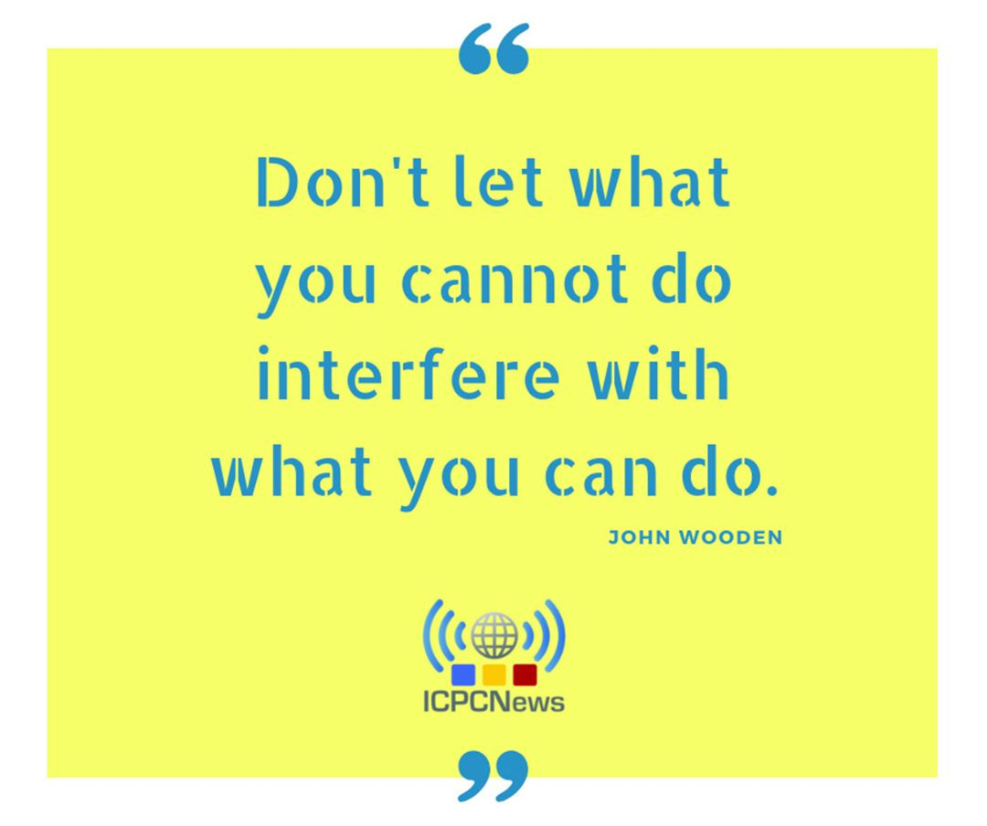
Qoutes

Slide 14
Self Training
Contest:
Part A - https://vjudge.net/contest/290580
Part B - https://vjudge.net/contest/290581
Date : 25 Mar 2019 until 24 Apr 2019 Time : 00.00 Length : 1 month Password : datastructure

